Slide 2
Topics
Introduction to Functions
Defining and Calling a Void Function
Designing a Program to Use Functions
Local Variables
Passing Arguments to Functions
Global Variables and Global Constants
Turtle Graphics: Modularizing Code with Functions

Slide 3
Topics (cont’d.)
Introduction to Value-Returning Functions: Generating Random Numbers
Writing Your Own Value-Returning Functions
The math Module
Storing Functions in Modules

Slide 4
Introduction to Functions
Function: group of statements within a program that perform as specific task
Usually one task of a large program
Functions can be executed in order to perform overall program task
Known as divide and conquer approach
Modularized program: program wherein each task within the program is in its own function

Slide 5
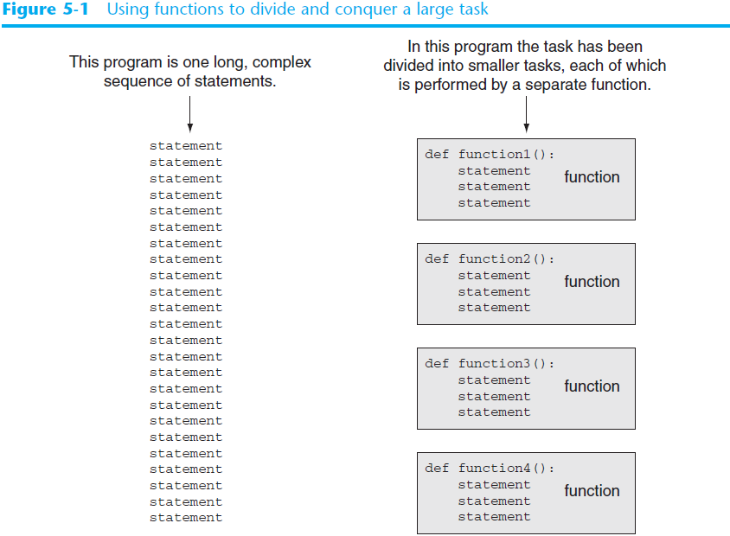
Divide and Conquer

Slide 6
Benefits of Modularizing a Program with Functions
The benefits of using functions include:
Simpler code
Code reuse
write the code once and call it multiple times
Better testing and debugging
Can test and debug each function individually
Faster development
Easier facilitation of teamwork
Different team members can write different functions

Slide 7
Void Functions and Value-Returning Functions
A void function:
Simply executes the statements it contains and then terminates.
A value-returning function:
Executes the statements it contains, and then it returns a value back to the statement that called it.
The input, int, and float functions are examples of value-returning functions.

Slide 8
Defining and Calling a Function
Functions are given names
Function naming rules:
Cannot use key words as a function name
Cannot contain spaces
First character must be a letter or underscore
All other characters must be a letter, number or underscore
Uppercase and lowercase characters are distinct

Slide 9
Defining and Calling a Function 1
Function name should be descriptive of the task carried out by the function
Often includes a verb
Function definition: specifies what function does
def function_name():
statement
statement

Slide 10
Defining and Calling a Function 2
Function header: first line of function
Includes keyword def and function name, followed by parentheses and colon
Block: set of statements that belong together as a group
Example: the statements included in a function

Slide 11
Defining and Calling a Function 3
Call a function to execute it
When a function is called:
Interpreter jumps to the function and executes statements in the block
Interpreter jumps back to part of program that called the function
Known as function return

Slide 12
Defining and Calling a Function 4
main function: called when the program starts
Calls other functions when they are needed
Defines the mainline logic of the program

Slide 13
Indentation in Python
Each block must be indented
Lines in block must begin with the same number of spaces
Use tabs or spaces to indent lines in a block, but not both as this can confuse the Python interpreter
IDLE automatically indents the lines in a block
Blank lines that appear in a block are ignored

Slide 14
Designing a Program to Use Functions
In a flowchart, function call shown as rectangle with vertical bars at each side
Function name written in the symbol
Typically draw separate flow chart for each function in the program
End terminal symbol usually reads Return
Top-down design: technique for breaking algorithm into functions

Slide 15
Designing a Program to Use Functions 1
Hierarchy chart: depicts relationship between functions
AKA structure chart
Box for each function in the program, Lines connecting boxes illustrate the functions called by each function
Does not show steps taken inside a function
Use input function to have program wait for user to press enter

Slide 16
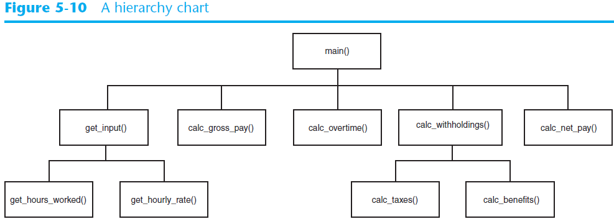
Designing a Program to Use Functions (cont’d.)

Slide 17
Local Variables
Local variable: variable that is assigned a value inside a function
Belongs to the function in which it was created
Only statements inside that function can access it, error will occur if another function tries to access the variable
Scope: the part of a program in which a variable may be accessed
For local variable: function in which created

Slide 18
Local Variables (cont’d.)
Local variable cannot be accessed by statements inside its function which precede its creation
Different functions may have local variables with the same name
Each function does not see the other function’s local variables, so no confusion

Slide 19
Passing Arguments to Functions
Argument: piece of data that is sent into a function
Function can use argument in calculations
When calling the function, the argument is placed in parentheses following the function name

Slide 20
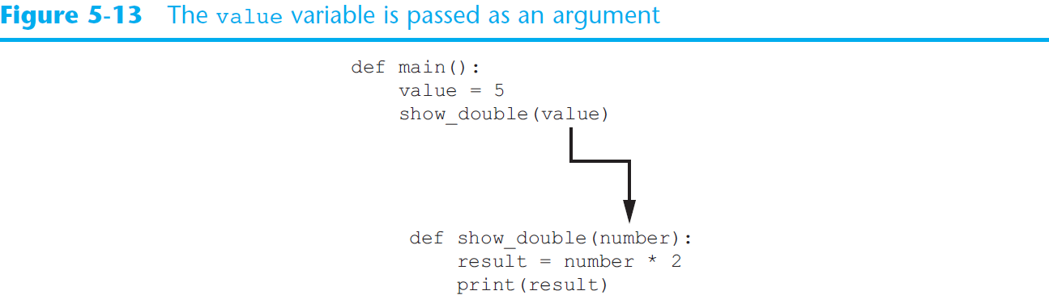
Passing Arguments to Functions (cont’d.)

Slide 21
Passing Arguments to Functions 2
Parameter variable: variable that is assigned the value of an argument when the function is called
The parameter and the argument reference the same value
General format:
def function_name(parameter):
Scope of a parameter: the function in which the parameter is used

Slide 22
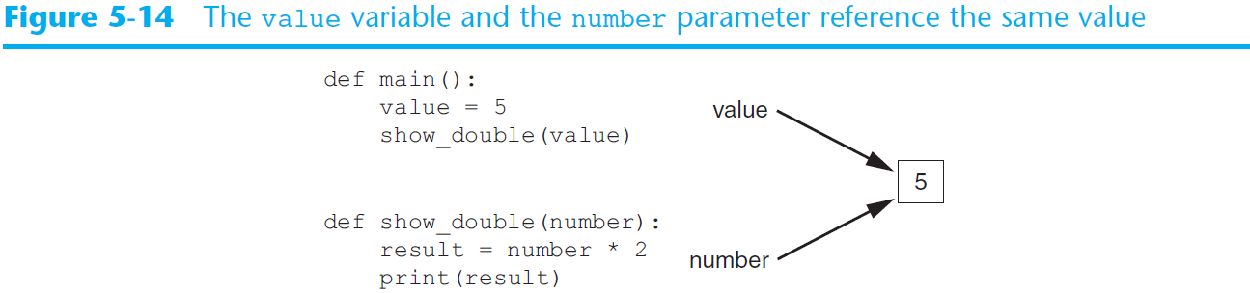
Passing Arguments to Functions 3

Slide 23
Passing Multiple Arguments
Python allows writing a function that accepts multiple arguments
Parameter list replaces single parameter
Parameter list items separated by comma
Arguments are passed by position to corresponding parameters
First parameter receives value of first argument, second parameter receives value of second argument, etc.

Slide 24
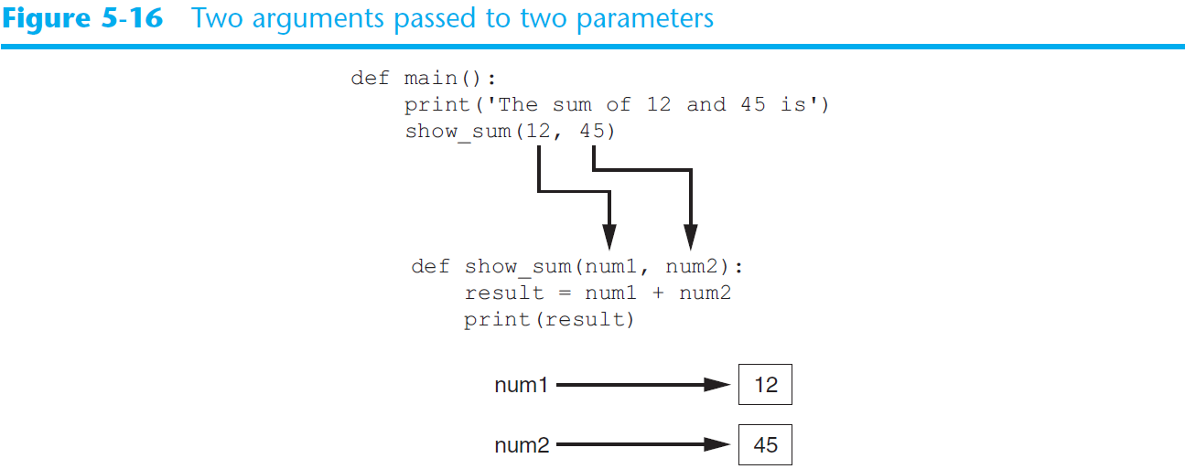
Passing Multiple Arguments (cont’d.)

Slide 25
Making Changes to Parameters
Changes made to a parameter value within the function do not affect the argument
Known as pass by value
Provides a way for unidirectional communication between one function and another function
Calling function can communicate with called function

Slide 26
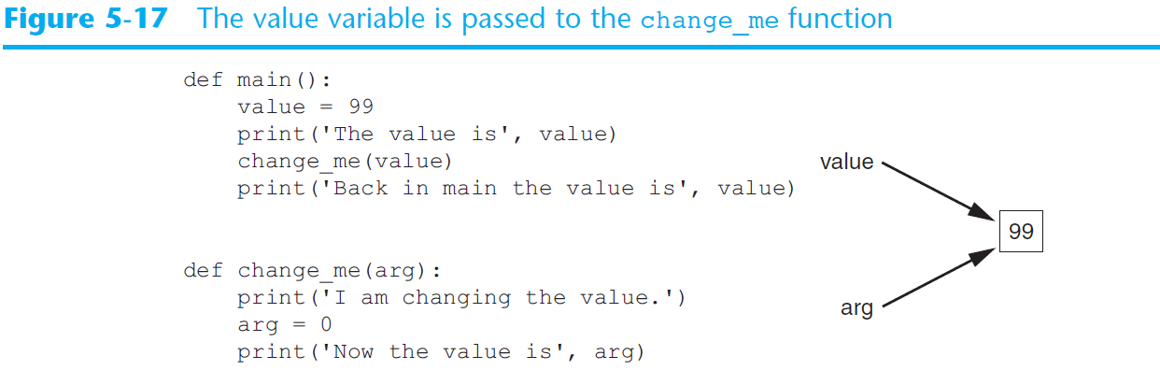
Making Changes to Parameters (cont’d.1)

Slide 27
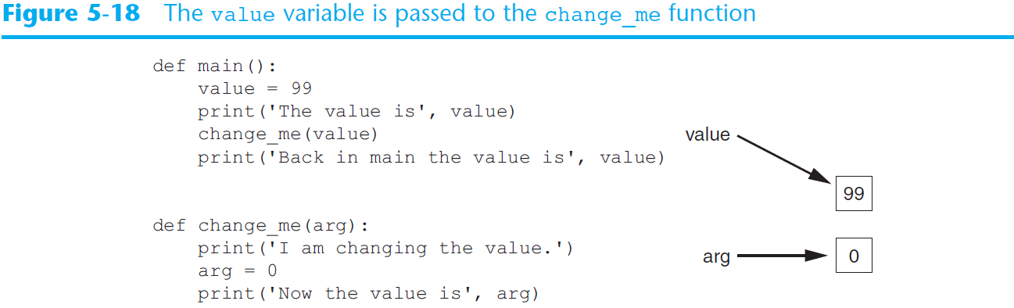
Making Changes to Parameters (cont’d.)
Figure 5-18
The value variable passed to the change_me function cannot be changed by it

Slide 28
Keyword Arguments
Keyword argument: argument that specifies which parameter the value should be passed to
Position when calling function is irrelevant
General Format:
function_name(parameter=value)
Possible to mix keyword and positional arguments when calling a function
Positional arguments must appear first

Slide 29
Global Variables and Global Constants
Global variable: created by assignment statement written outside all the functions
Can be accessed by any statement in the program file, including from within a function
If a function needs to assign a value to the global variable, the global variable must be redeclared within the function
General format: global variable_name

Slide 30
Global Variables and Global Constants (cont’d.)
Reasons to avoid using global variables:
Global variables making debugging difficult
Many locations in the code could be causing a wrong variable value
Functions that use global variables are usually dependent on those variables
Makes function hard to transfer to another program
Global variables make a program hard to understand

Slide 31
Global Constants
Global constant: global name that references a value that cannot be changed
Permissible to use global constants in a program
To simulate global constant in Python, create global variable and do not re-declare it within functions

Slide 32
Introduction to Value-Returning Functions: Generating Random Numbers
void function: group of statements within a program for performing a specific task
Call function when you need to perform the task
Value-returning function: similar to void function, returns a value
Value returned to part of program that called the function when function finishes executing

Slide 33
Standard Library Functions and the import Statement
Standard library: library of pre-written functions that comes with Python
Library functions perform tasks that programmers commonly need
Example: print, input, range
Viewed by programmers as a “black box”
Some library functions built into Python interpreter
To use, just call the function

Slide 34
Standard Library Functions and the import Statement (cont’d.)
Modules: files that stores functions of the standard library
Help organize library functions not built into the interpreter
Copied to computer when you install Python
To call a function stored in a module, need to write an import statement
Written at the top of the program
Format: import module_name

Slide 35
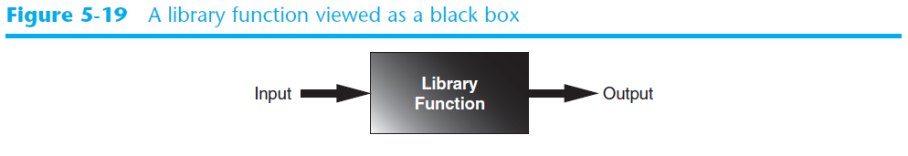
Standard Library Functions and the import Statement (cont’d.1)

Slide 36
Generating Random Numbers
Random number are useful in a lot of programming tasks
random module: includes library functions for working with random numbers
Dot notation: notation for calling a function belonging to a module
Format: module_name.function_name()

Slide 37
Generating Random Numbers (cont’d.)
randint function: generates a random number in the range provided by the arguments
Returns the random number to part of program that called the function
Returned integer can be used anywhere that an integer would be used
You can experiment with the function in interactive mode

Slide 38
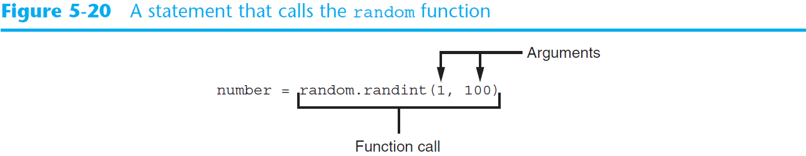
Generating Random Numbers (cont’d.1)

Slide 39
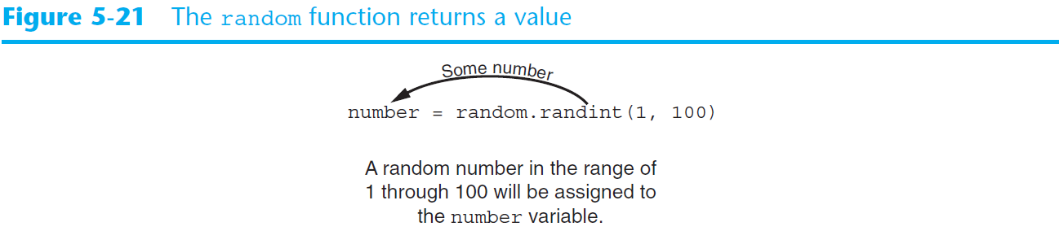
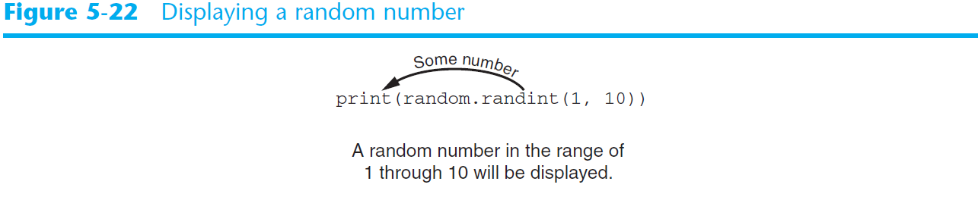
Generating Random Numbers (cont’d.2)

Slide 40
Generating Random Numbers (cont’d.3)
randrange function: similar to range function, but returns randomly selected integer from the resulting sequence
Same arguments as for the range function
random function: returns a random float in the range of 0.0 and 1.0
Does not receive arguments
uniform function: returns a random float but allows user to specify range

Slide 41
Random Number Seeds
Random number created by functions in random module are actually pseudo-random numbers
Seed value: initializes the formula that generates random numbers
Need to use different seeds in order to get different series of random numbers
By default uses system time for seed
Can use random.seed() function to specify desired seed value

Slide 42
Writing Your Own Value-Returning Functions
To write a value-returning function, you write a simple function and add one or more return statements
Format: return expression
The value for expression will be returned to the part of the program that called the function
The expression in the return statement can be a complex expression, such as a sum of two variables or the result of another value- returning function

Slide 43
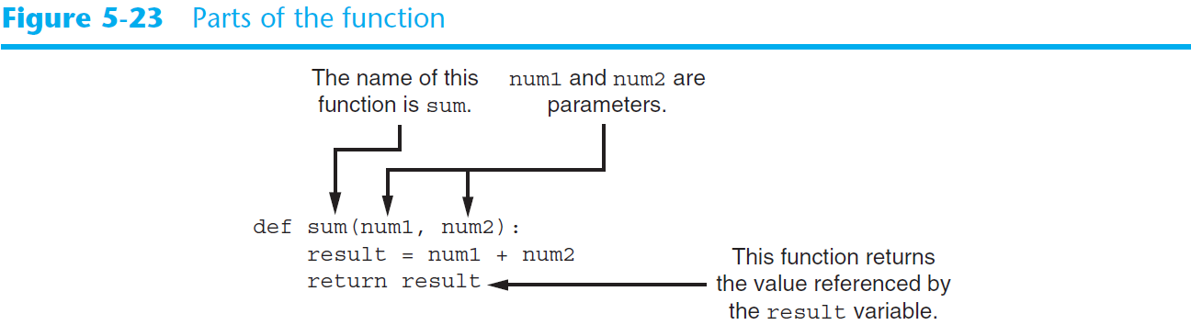
Writing Your Own Value-Returning Functions (cont’d.)

Slide 44
How to Use Value-Returning Functions
Value-returning function can be useful in specific situations
Example: have function prompt user for input and return the user’s input
Simplify mathematical expressions
Complex calculations that need to be repeated throughout the program
Use the returned value
Assign it to a variable or use as an argument in another function

Slide 45
Using IPO Charts
IPO chart: describes the input, processing, and output of a function
Tool for designing and documenting functions
Typically laid out in columns
Usually provide brief descriptions of input, processing, and output, without going into details
Often includes enough information to be used instead of a flowchart

Slide 46
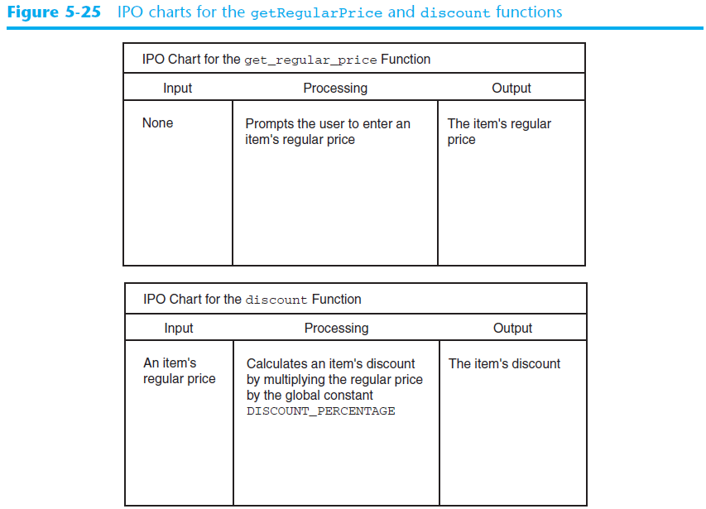
Using IPO Charts (cont’d.)

Slide 47
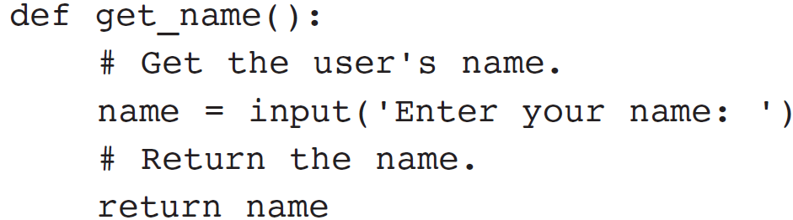
Returning Strings
You can write functions that return strings
For example:

Slide 48
Returning Boolean Values
Boolean function: returns either True or False
Use to test a condition such as for decision and repetition structures
Common calculations, such as whether a number is even, can be easily repeated by calling a function
Use to simplify complex input validation code

Slide 49
Returning Multiple Values
In Python, a function can return multiple values
Specified after the return statement separated by commas
Format: return expression1,
expression2, etc.
When you call such a function in an assignment statement, you need a separate variable on the left side of the = operator to receive each returned value

Slide 50
The math Module
math module: part of standard library that contains functions that are useful for performing mathematical calculations
Typically accept one or more values as arguments, perform mathematical operation, and return the result
Use of module requires an import math statement

Slide 51
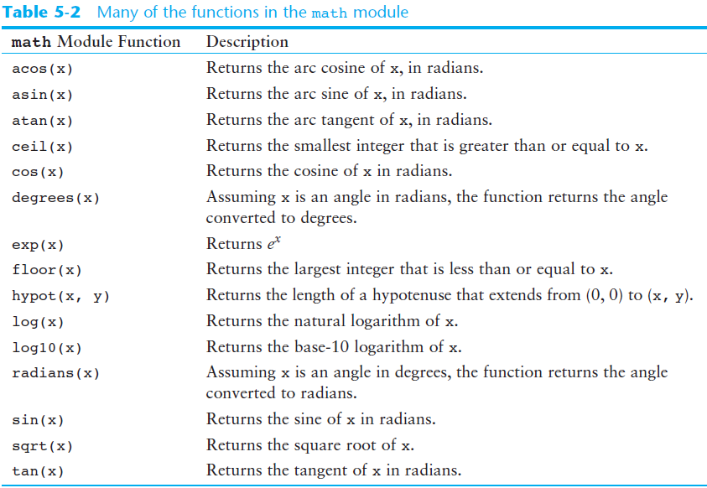
The math Module (cont’d.)

Slide 52
The math Module (cont’d.1)
The math module defines variables pi and e, which are assigned the mathematical values for pi and e
Can be used in equations that require these values, to get more accurate results
Variables must also be called using the dot notation
Example:
circle_area = math.pi * radius**2

Slide 53
Storing Functions in Modules
In large, complex programs, it is important to keep code organized
Modularization: grouping related functions in modules
Makes program easier to understand, test, and maintain
Make it easier to reuse code for multiple different programs
Import the module containing the required function to each program that needs it

Slide 54
Storing Functions in Modules (cont’d.)
Module is a file that contains Python code
Contains function definition but does not contain calls to the functions
Importing programs will call the functions
Rules for module names:
File name should end in .py
Cannot be the same as a Python keyword
Import module using import statement

Slide 55
Menu Driven Programs
Menu-driven program: displays a list of operations on the screen, allowing user to select the desired operation
List of operations displayed on the screen is called a menu
Program uses a decision structure to determine the selected menu option and required operation
Typically repeats until the user quits

Slide 56
Turtle Graphics: Modularizing Code with Functions
Commonly needed turtle graphics operations can be stored in functions and then called whenever needed.
For example, the following function draws a square. The parameters specify the location, width, and color.
def square(x, y, width, color):
turtle.penup() # Raise the pen
turtle.goto(x, y) # Move to (X,Y)
turtle.fillcolor(color) # Set the fill color
turtle.pendown() # Lower the pen
turtle.begin_fill() # Start filling
for count in range(4): # Draw a square
turtle.forward(width)
turtle.left(90)
turtle.end_fill() # End filling

Slide 57
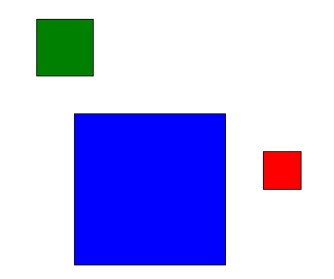
Turtle Graphics: Modularizing Code with Functions 1
The following code calls the previously shown square function to draw three squares:
square(100, 0, 50, 'red')
square(-150, -100, 200, 'blue')
square(-200, 150, 75, 'green')

Slide 58
Turtle Graphics: Modularizing Code with Functions 2
The following function draws a circle. The parameters specify the location, radius, and color.
def circle(x, y, radius, color):
turtle.penup() # Raise the pen
turtle.goto(x, y - radius) # Position the turtle
turtle.fillcolor(color) # Set the fill color
turtle.pendown() # Lower the pen
turtle.begin_fill() # Start filling
turtle.circle(radius) # Draw a circle
turtle.end_fill() # End filling

Slide 59
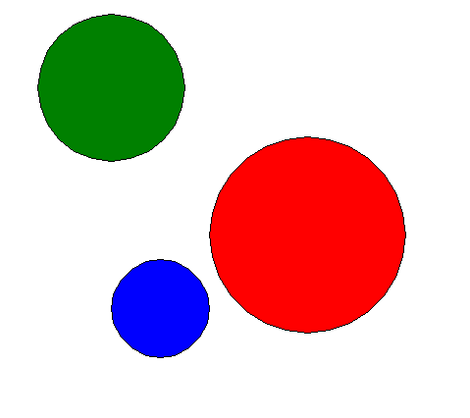
Turtle Graphics: Modularizing Code with Functions 3
The following code calls the previously shown circle function to draw three circles:
circle(0, 0, 100, 'red')
circle(-150, -75, 50, 'blue')
circle(-200, 150, 75, 'green')

Slide 60
Turtle Graphics: Modularizing Code with Functions 4
The following function draws a line. The parameters specify the starting and ending locations, and color.
def line(startX, startY, endX, endY, color):
turtle.penup() # Raise the pen
turtle.goto(startX, startY) # Move to the starting point
turtle.pendown() # Lower the pen
turtle.pencolor(color) # Set the pen color
turtle.goto(endX, endY) # Draw a square

Slide 61
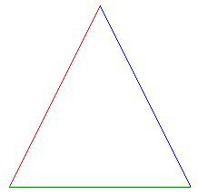
Turtle Graphics: Modularizing Code with Functions 5
The following code calls the previously shown line function to draw a triangle:
TOP_X = 0
TOP_Y = 100
BASE_LEFT_X = -100
BASE_LEFT_Y = -100
BASE_RIGHT_X = 100
BASE_RIGHT_Y = -100
line(TOP_X, TOP_Y, BASE_LEFT_X, BASE_LEFT_Y, 'red')
line(TOP_X, TOP_Y, BASE_RIGHT_X, BASE_RIGHT_Y, 'blue')
line(BASE_LEFT_X, BASE_LEFT_Y, BASE_RIGHT_X, BASE_RIGHT_Y, 'green')

Slide 62
Summary
This chapter covered:
The advantages of using functions
The syntax for defining and calling a function
Methods for designing a program to use functions
Use of local variables and their scope
Syntax and limitations of passing arguments to functions
Global variables, global constants, and their advantages and disadvantages

Slide 63
Summary (cont’d.)
Value-returning functions, including:
Writing value-returning functions
Using value-returning functions
Functions returning multiple values
Using library functions and the import statement
Modules, including:
The random and math modules
Grouping your own functions in modules
Modularizing Turtle Graphics Code

